Slide 1
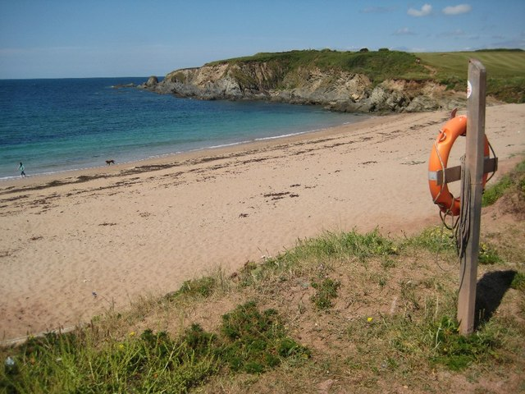

PE:
As well-rounded, active citizens, our children will feel a sense of belonging by immersing themselves in a wide range of physical activities as well as welly walks. This term, our PE sessions will be guided by Premier Sports and will be on a Wednesday. We will be practising our skills ready for Sports Day!
Forest School:
We are extremely fortunate to be able to access provision for outdoor learning. We will be heading off on our adventures after the Easter holidays. We will have Forest School on Tuesday afternoons.
Science:
As Scientists, we will be learning all about ‘Looking after plants’. During this unit we will be using a variety of scientific skills such as: carrying out simple tests, creating suggestions from our observations, identifying, classifying and gathering and recording data.
Maths:
As Mathematicians, Year 1 will be delving into the topics: time, money, fractions, place value (within 100), multiplication & division and position & direction. Throughout the math’s lessons, we will be using our mathematical knowledge to solve problems. We will be continuing to develop the children’s ability to explain, prove and show their answers in another way to develop their mastery of maths.
Art & Design:
As artists, we will be exploring the work of Gloria Petyarre. We will be studying her Aboriginal art and discussing how her work can inspire our own work. We will learn a range of printing techniques and will use lots of bright colours!
Design & Technology:
As designers, our project this term and our final outcome will be to make a fruit smoothie. Throughout this unit we will be looking at a range of different fruit and how we can prepare food safely and hygienically.
RE:
To begin, we will be looking at the question ‘What does it mean to belong to a faith community?’ We will be exploring different communities both religious and secular.
In Summer 2 our focus question will be ‘How should we care for the world and others, and why does it matter?’
Christian Distinctiveness:
We demonstrate our Christian Values through daily acts of collective worship, singing worship and family group acts of worship.
Spiritualty – This term we will explore the big questions ‘If you can’t see something is it real?’ and ‘How big is the sky?’
RHE:
As healthy, confident and resilient children, we will be learning about citizenship and being part of a community in our school, local area and beyond. We will also be learning and understanding about money and economic well being.
We will spend Summer 2 talking about transition into the next academic year. It is important the children have this time to understand the changes in September.
Yarmer Class
Year 1
Summer Term 25-26
English:
During the Summer Term, our daily English lessons will include Read Write Inc., sentence-building activities and spelling. These sessions will help children strengthen their phonics and decoding skills, while also building their confidence and stamina in writing so that it becomes more natural for them.
We will also continue to develop comprehension skills through reading our Favourite Five books and a range of texts from our class library. The children will practise talking about what they have read, sharing their ideas, and finding answers within the text.
In addition, we will spend time improving handwriting using our 4 Ps approach, supporting children to develop neat, well-formed writing and take pride in their work.
The Year 1 children will complete the Phonics Screening Check in June.
History and Geography:
As Geographers, we will be learning all about Australia. We will be retrieving our knowledge of human and physical features, climates and landmarks. We will also be learning about the different animals in Australia and will compare Australia to the United Kingdom.
As Historians, we will be learning all about The Great Fire of London. We will be looking at sources and researching to gather a picture of how the fire started and how it impacted the lives of those living in London. We will learn about Samuel Pepys and Puddling Lane and understand why the Great Fire of London was so significant in our history.
Music:
As musicians, we will be learning the music and song ‘Come Dance With Me’. We will be learning about the upbeat song, practising the beat using different methods and learning the lyrics to sing along.

