Slide 1
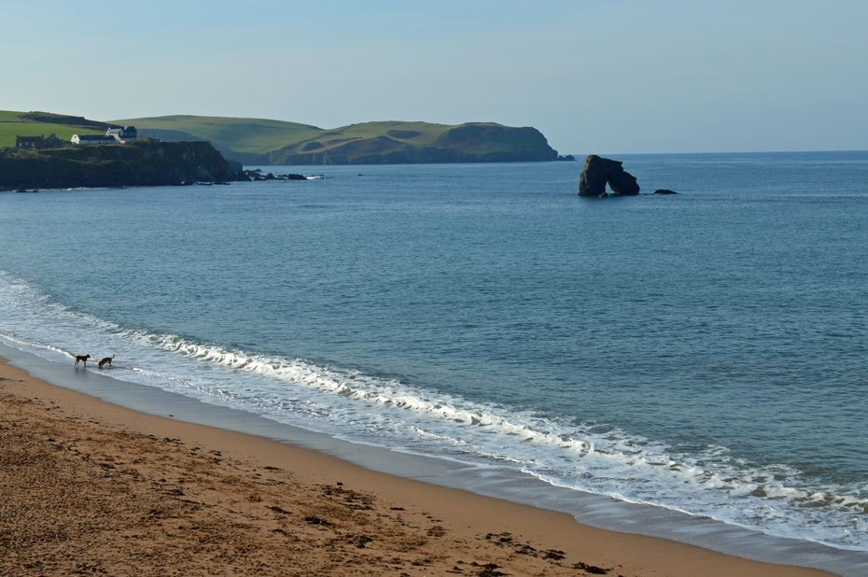
PE:
As well-rounded, active citizens, our children will feel a sense of belonging by immersing themselves in a wide range of physical activities. This term, our sessions will be focused on cricket. They will take place on a Wednesday mornings.
Science:
As scientists, the Year 1s will be learning about animals including humans. We will start with learning our parts of the body, and about the 5 different senses. We will then learn all about different animals including herbivores, carnivores and omnivores, animals and their offspring and what animals and humans need to stay alive.
Maths:
As mathematicians, Year 1 will begin the term with a strong focus on place value, initially exploring numbers to 10 before moving on to numbers to 20. The children will use a range of practical resources to count forwards and backwards and represent numbers in different ways. They will then deepen their understanding of addition and subtraction within 10, using the part-whole model to explore number facts and different ways of representing calculations. The children will also learn to read, interpret and use the +, − and = symbols to write simple number sentences.
Art & Design: As Artists, we will be exploring the work of the local artist Brian Pollard. We will analyse his work and consider how he uses shape and colour within his paintings. Initially we will make simple sketches based on what we can see within images. We will than use local landscape and seascapes to inspires us to draw and paint in the style of Brian Pollard.
Design & Technology:
As Designers, we will be learning about different joining techniques. We will explore different materials and consider how best to join them. Joining techniques will include gluing, stapling, safety pins, pinning and sewing.
Computing:
During our computing lessons, we will be focusing on the theme, ‘Technology Around Us.’ We will ponder what we already know about technology and think about how we use it within the classroom. We will ask questions about how technology can help us and explore using simple technology. This will include, knowing how to turn on a computer, open a program, use a mouse and keyboard.
Music:
As musicians, we will be focusing on the unit ‘ Tony Chestnut’ and ‘Carnival of the Animals’ Throughout the unit the children pupils will learn to play the melody of the song on tuned percussion and making up call-and-response patterns with actions, their voices and with instruments
Yarmer
Year 1
Autumn Term 2026
RHE:
This term, our learning in RHE will focus on understanding and managing emotions. Children will learn to recognise a range of feelings in themselves and others, develop strategies for managing difficult emotions, and understand the importance of talking about how they feel. They will explore how emotions can affect behaviour, build resilience, and learn ways to maintain positive mental wellbeing and healthy relationships.
Geography:
As geographers, we will be thinking about the local environment, we will identify seasonal changes in the UK and how this is changing due to human impact. Using our geographical skills, we will identify physical and human features and how these change and impact the environment around us. We will explore the term climate and what it is.
History:
As historians, Year 1 will be thinking about Sir Francis Drake and using their historical enquiry skills to answer the question ‘was he a pirate or a hero?’ We will discover the journey that he went on, including places that are near to us. We will be looking at events that happened during his life and using sources and artefacts to support our understanding.
RE:
This half term the children will be focusing on Christianity, with a particular focus on the Creation story. We will be learning how Christians believe that God created the world in 6 days and rested on the 7th day. We will be thinking about how stained-glass windows would help to tell bible stories before people could read.
Christian Distinctiveness:
We demonstrate our Christian Values through daily acts of collective worship, singing worship and family group acts of worship.
English:
During the Autumn term, our daily English session will be made up of Read Write Inc, Sentence Builders, handwriting and spelling. These sessions are about embedding and applying the children’s decoding skills, so reading becomes second nature. We will also spend more time focusing on developing their comprehensions skills so they can talk about what they have read with confidence and also retrieve answers from the text they have read.
During their RWInc sessions the children also have the opportunity to build up their stamina for writing. They learn to hold and write a sentence, build a sentence around a specific phrase and also write for different purposes, such as writing to entertain, story, poetry or writing to inform through fact files and posters.

