Slide 1
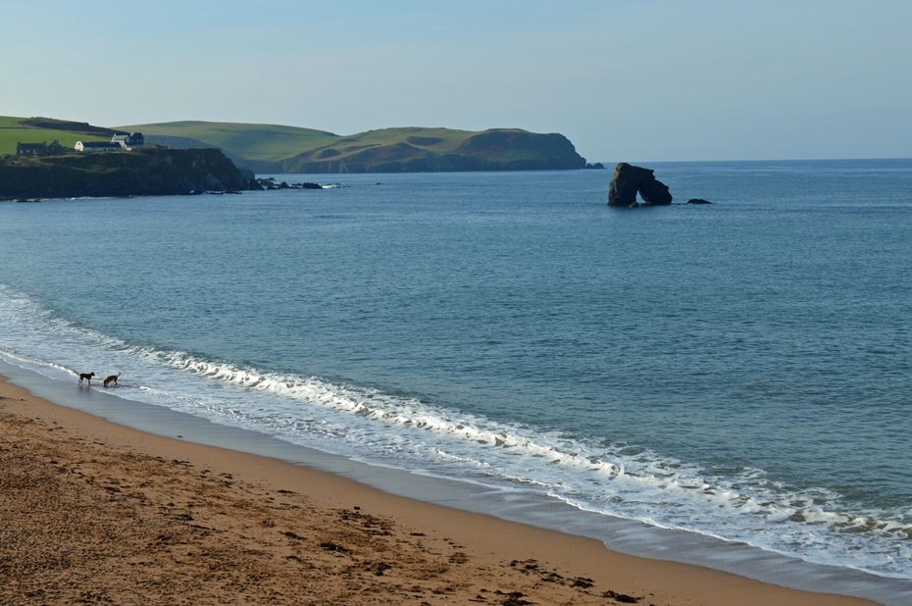
PE:
As well-rounded, active citizens, our children will feel a sense of belonging by immersing themselves in a wide range of physical activities. This term, our sessions will be focused on cricket. They will take place on a Wednesday mornings.
Science:
As scientists, we will be learning all about everyday materials. They will be developing their understanding of objects and the materials from which they are made. They will classify and sort items into categories such as wood, plastic, glass, metal, fabric and paper. Once comfortable with the term ‘materials’, they will deepen their understanding by describing the properties of different materials and make simple comparisons.
Maths:
As mathematicians, Year 2 will begin by building on their counting skills from Year 1 with a focus on counting forwards and backwards to 100. We will also explore how we can represent numbers to 100 with a range of materials and explain how a number is made up with tens and ones. We will then move on to focus on addition and subtraction facts within 100. We finish the term with geometry, exploring 2d and 3d shapes and lines of symmetry.
Art & Design: As Artists, we will be exploring the work of the local artist Brian Pollard. We will analyse his work and consider how he uses shape and colour within his paintings. Initially we will make simple sketches based on what we can see within images. We will than use local landscape and seascapes to inspires us to draw and paint in the style of Brian Pollard.
Design & Technology:
As Designers, we will be learning about different joining techniques. We will explore different materials and consider how best to join them. Joining techniques will include gluing, stapling, safety pins, pinning and sewing.
Computing:
During our computing lessons, we will be focusing on the theme, ‘Technology Around Us.’ We will ponder what we already know about technology and think about how we use it within the classroom. We will ask questions about how technology can help us and explore using simple technology. This will include, knowing how to turn on a computer, open a program, use a mouse and keyboard.
Forest School:​
We are extremely fortunate to be able to access provision for outdoor learning. We will be heading off on our adventures after half term!​
Please ensure children come to school dressed for Forest School with appropriate clothing and footwear for these sessions.​
Leas Foot
Year 2
Autumn Term 2026
RHE:
As healthy, confident and resilient children we will be exploring how we can respect ourselves, others, as well as friends and families. We will be thinking about how we have healthy relationships with our family and our friends, including who we should trust. We will discuss how we can help different groups of people in our environment and our community.
Music:
As musicians, we will be focusing on the unit ‘ Tony Chestnut’ and ‘Carnival of the Animals’ Throughout the unit the children pupils will learn to play the melody of the song on tuned percussion and making up call-and-response patterns with actions, their voices and with instruments
Geography:
As geographers, will be thinking about the local environment, we will identify seasonal changes in the UK and how this is changing due to human impact. Using our geographical skills, we will identify physical and human features and how these change and impact the environment around us. We will explore the term climate and what it is.
History:
As historians, Leas Foot will be thinking about Sir Francis Drake and using their historical enquiry skills to answer the question ‘was he a pirate or a hero?’ We will discover the journey that he went on, including places that are near to us. We will be looking at events that happened during his life and using sources and artefacts to support our understanding.
RE:
This half term the children will be focusing on Christianity, with the question ‘Who do Christians say made the world?’ We will listen to a range of stories for the Bible and consider how they guide Christians in their beliefs about prayer.
Christian Distinctiveness:
We demonstrate our Christian Values through daily acts of collective worship, singing worship and family group acts of worship.
English:
During the Autumn term, our daily English session will be made up of Read Write Inc, SPAG and handwriting. These sessions are about embedding and applying the children’s decoding skills, so reading becomes second nature. We will also spend more time focusing on developing their comprehensions skills so they can talk about what they have read with confidence and also retrieve answers from the text they have read. For those children moving on from RWInc, they will be following the Jane Considine English scheme which is a structured way of teaching children to write confidently, creatively, and successfully.

