Slide 1
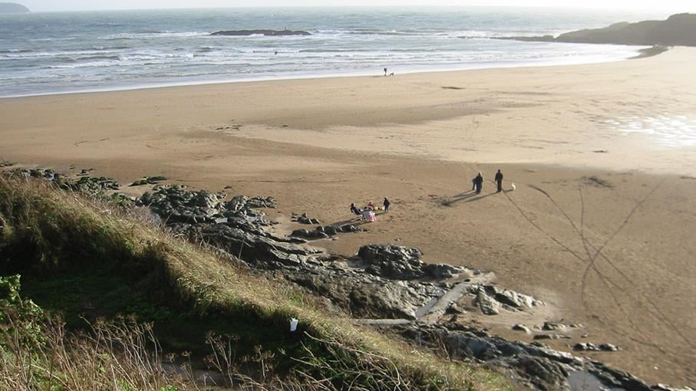
PE:
This half term, we are welcoming in Devon Cricket to work with the children. Here the children will be developing their cricket skills by learning and practicing ket techniques such as batting, bowling, catching and fielding. They will also build their teamwork, communication and sportsmanship skills.
Forest School:
We are extremely fortunate to be able to access provision for outdoor learning. These sessions will take place on Tuesdays.
Please ensure children come to school with appropriate clothing and footwear for these sessions. We start after October Half Term.
Science:
As scientists, in this unit of learning, Year 3 will be learning about rocks, and Year 4 will be learning about states of matter – solids, liquids and gases. Year 3s will be identifying the different types of rocks, and where and how they can be used. Year 4s will be learning about how states of matter can change depending on their environment.
Maths:
As mathematicians, we will consolidate and extend our knowledge of Place Value, developing our understanding of numbers up to 1000 for Year 3, and numbers to 10,000 for Year 4s. We will learn how to use these numbers on number lines, rounding and looking at Roman numerals. We will also have a strong focus on times tables, particularly for Year 4s who will be learning up to 12x12 throughout the year.
Art & Design
As artists, we will be exploring the work of Martin Bush. The children will learn about his distinctive style and how he uses bold colours, texture and layers to create striking pieces of artwork inspired by the natural world., The children will experiment with colour mixing, pattern, texture and composition to create their own pieces, developing their creativity and artistic skills along the way.
Sedgewell Cove
Autumn 2026
Music:
As musicians the children will develop their musical skills through singing, playing, composing and performing. They will learn how songs are created, write simple lyrics, and create their own music using just three notes. Through these activities, pupils will build confidence, creativity and teamwork while developing their understanding of rhythm, pitch and musical notation.
RHE:
This term, our learning in RHE will focus on understanding and managing emotions. Children will learn to recognise a range of feelings in themselves and others, develop strategies for managing difficult emotions, and understand the importance of talking about how they feel. They will explore how emotions can affect behaviour, build resilience, and learn ways to maintain positive mental wellbeing and healthy relationships.
French
As linguists, the children will build their confidence in speaking, listening, reading and writing French. They will learn and practise key everyday vocabulary, including words and phrases related to school life. Through songs, games and conversations, pupils will develop their communication skills and gain a greater understanding of French language and culture. We are starting with learning basic French including colours and emotions.
RE:
To begin the term in RE, we will be learning about the Christian faith and exploring the question “What does it mean if Christians believe God is holy and loving?" During this unit, we will be reading stories from the Bible, from both the Old and New Testament, to explore ways in which Christians believe God is both holy and loving. We will also reflect on our own values and learn why it is important to respect people who hold different beliefs and worldviews.
Christian Distinctiveness:
We demonstrate our Christian Values through daily acts of collective worship, singing worship and family group worship.
History and Geography:
As geographers, we will explore settlements and land use, learning about the different types of settlements and how land is used for a variety of purposes. We will investigate villages, towns and cities, and examine how physical and human features influence where people choose to live.
As historians, we will explore the Anglo-Saxons, discovering when and why they came to Britain and the impact they had on life in early England. The children will learn about Anglo-Saxon homes, food, clothing, beliefs and daily life, as well as the roles of different people within Anglo-Saxon society.
English:
As writers, our learning will be underpinned by the purpose of writing ‘to entertain’. We will immerse ourselves into a variety of different texts as well a short films with a narrative as our main writing outcome. Each lesson, we will focus on key skills to improve our writing. For example, using noun phrases, repetition, fronted adverbials and more. Our first unit is based on the text ‘The True Story of the Three Little Pigs’. For our reading lessons in class, we will be using our DERIC reading skills to retrieve information and answer questions related to our book ‘Beowulf’.

