Slide 1
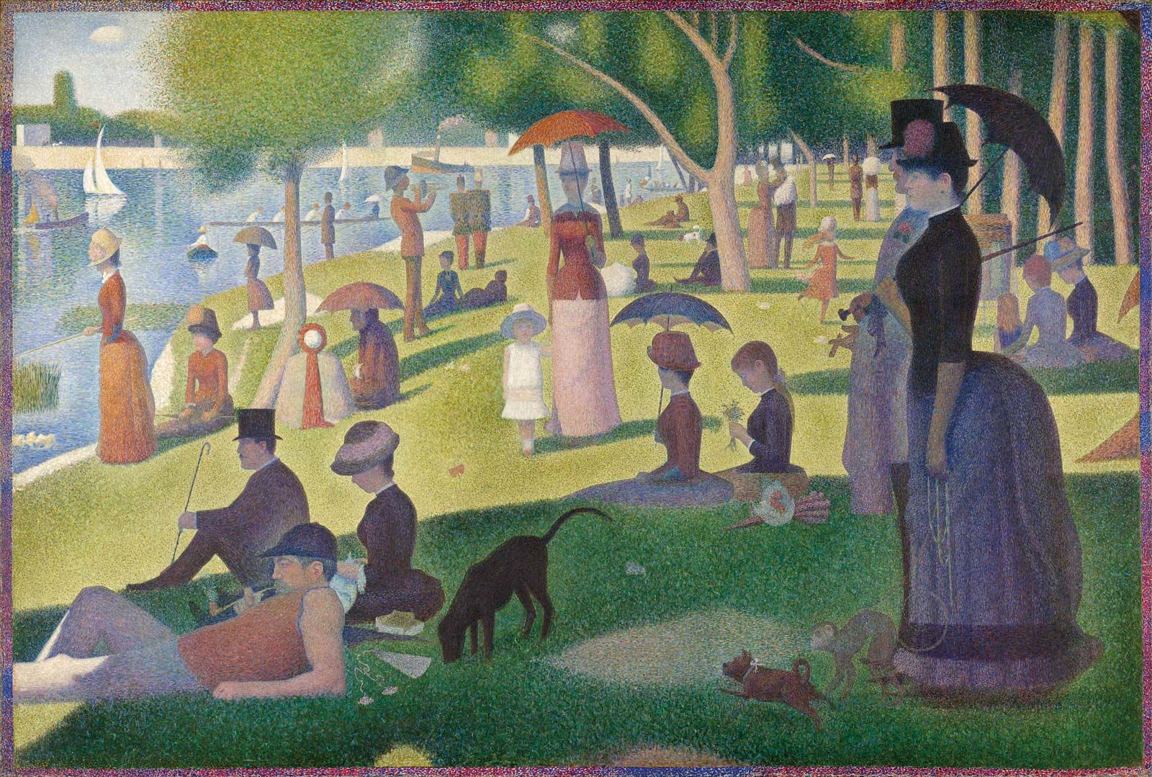
PE:
As well-rounded, active citizens, our children will feel a sense of belonging by immersing themselves in a wide range of physical activities. This term, our sessions will be guided by an external PE provider, and they will take place on Wednesdays. We will be learning cricket and developing our athletics skills.
Music:
As musicians, we will be combining singing and composition through learning the ballad of ‘Keep the Home Fires Burning’, celebrating the brave service of those at war. This is a good introduction to the social and historical context of songs and music written around the time of World War 1.
English: ​
As writers, our learning will be underpinned by the purpose of writing ‘to inform’. We will immerse ourselves into a variety of different informative and explanation texts with our main writing outcome being a biography. Initially we will be using Sir David Attenborough, outlining his personal life and achievements, as inspiration. We will be using our DERIC (decode, explain, retrieve, infer and choice) reading skills to retrieve information and answer questions related to different versions of ‘Hansel and Gretel’ to identify differences and similarities
French​
As linguists, we will explore different classroom items and learn to use the correct determiner. Following this, we will be reading the classic tale of Goldilocks in French, exploring new words and vocabulary related to the story.
Butter Cove
Year 4 & 5
Summer 2025
Maths:
As mathematicians, Year 4 and 5 will be diving into the exciting world of geometry! Our main focus will be on exploring shape, as well as position and direction. Pupils will be learning to identify and classify a range of 2D and 3D shapes, understand their properties, and use mathematical vocabulary to describe them accurately. They'll also be working with coordinates, translations and symmetry.
Art & Design:​
As artists, we will be learning about the work of Georges Seurat and his creation of the Pointillism style. We will explore and apply the Pointillism technique and develop an appreciation for different artistic styles and techniques. We will gain a deeper understanding of Seurat's contributions to the art world and the unique beauty of Pointillism.
RHE: ​
As responsible citizens living in the wider world, we will learn that safety of ourselves and others is crucial for a happy and healthy society. We will be learning how to deal with different scenarios including making emergency calls, handling bites, stings and allergic reactions, plus how to stay safe and act kindly online whilst learning to identify what might be genuine and what might not in our ever-changing online world.
Geography:
As geographers, we will be learning about China. They will explore its location, major landforms, and how human activity has impacted its physical geography. Pupils will also look at China’s rapid economic growth, key industries, and its role in the world. The topic will include a look at famous tourist attractions and cultural landmarks.
History:
As historians, we will be learning about Shang Dynasty and its significance in ancient Chinese history. We will be exploring this period of ancient history, developing an understanding of early civilizations, and appreciating their contributions to modern society. We will develop an understanding of historical timelines and cultural developments through learning about the structure of their societies, the achievements and contributions they made towards the modern world and also their culture and the way they spent their daily lives.
RE:​
This term the children will be learning pupils about the events of Pentecost found in the Bible, considering which events would be needed to retell the story for someone else. They will consider what the events might have meant for the first Christians and what they mean for Christians today. Pupils will learn how Christians today show their beliefs about the Holy Spirit in worship and the way that they live their lives.
Christian Distinctiveness:​
We demonstrate our Christian Values through daily acts of collective worship, singing worship and family group acts of worship.
Science:
As scientists, Year 4 and 5 are learning about Animals Including Humans. They’ll explore the human body, including the digestive, circulatory, and skeletal systems, and understand the importance of nutrition, exercise, and health. Pupils will compare humans with other animals and carry out investigations to see how our bodies work and how to keep them healthy.

