Slide 1
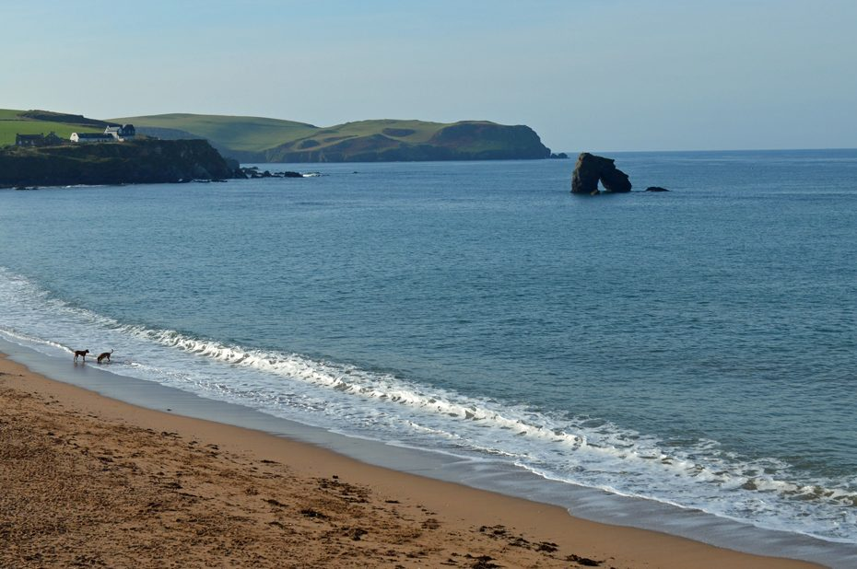
PE:
As well-rounded, active citizens, our children will feel a sense of belonging by immersing themselves in a wide range of physical activities. This term, our sessions will be guided by the Premier Sports. They will take place on a Wednesday afternoon.
We are also having our Forest School sessions on Tuesday afternoons this half term!
Science:
As scientists, the Year 1s will be learning about animals including humans. We will start with learning our parts of the body, and about the 5 different senses. We will then learn all about different animals including herbivores, carnivores and omnivores, animals and their offspring and what animals and humans need to stay alive.
Maths:
As Mathematicians, the Year 1s will be exploring numbers within 20, adding and subtracting numbers and finding the parts and wholes of numbers. We will then be exploring numbers to 50, as well as finding length and height, and mass and volume.
Art & Design: As Artists, we will be learning the skill of weaving. We will begin with weaving paper, understanding the technique needed, before moving onto weaving using threads and other materials. We will be creating a final piece showcasing our local area.
Design & Technology:
As Designers, we will be learning mechanisms, wheels and axles. We will first identify what each component means and where they are located on a simple model of a car. We will design and create a simple vehicle for an alien to move around their planet. We will then evaluate our models, considering what went well, and what we might change next time.
Computing:
This term, we will be learning about programming and using bee bots to program and control a moving robot. We will also be considering how technology helps us every day, and what technology we have around us.
Music:
As musicians, we will be listening to and appraising a range of different songs, learning how to find a beat from a range of music. We will learn to identify different instruments used in music pieces. We will then use this to improvise and create our own melodies and music pieces using a variety of instruments.
RHE:
As healthy, confident and resilient children we will be exploring how we build relationships with friends and family. We will be thinking about ourselves and our health and wellbeing. What am I like? And how is everyone different from each other? We will learn about the importance of sleep, hand and personal hygiene, how to relax, sun safety, allergies and more.
Yarmer
Year 1
Spring Term 2025
Geography:
As geographers, we will be learning about hot and cold countries. We will be learning about the world around us, including the 7 continents and 5 oceans of the world, and what continents are hotter and colder than others. We will learn about the equator, and the northern and southern hemisphere and how that effects temperatures.
History:
As historians, Year 1 will be learning about Christopher Columbus and Neil Armstrong, great explorers. We will be learning about who they were, what they achieved, and why it was significant at the time. We will also learn about the moon landing, and how people would have felt watching it happen live.
English:
During the Spring term, our daily English session will continue to be Read Write Inc and handwriting. These sessions are about embedding and applying the children’s decoding skills, so reading becomes second nature. We will also spend more time focusing on developing their comprehensions skills so they can talk about what they have read with confidence and also retrieve answers from the text they have read.
During their RWInc sessions the children have the opportunity to build up their stamina for writing. They learn to build a sentence around a specific word and also write for different purposes, such as writing to entertain, story, poetry or writing to inform through fact files and posters.
RE:
This half term the children will be focusing on Islam, who are Muslims and how do they live? We will learn about their God, Allah, their place of worship and the Prophet Muhammad.
Christian Distinctiveness:
We demonstrate our Christian Values through daily acts of collective worship, singing worship and family group acts of worship.

